Slide 1
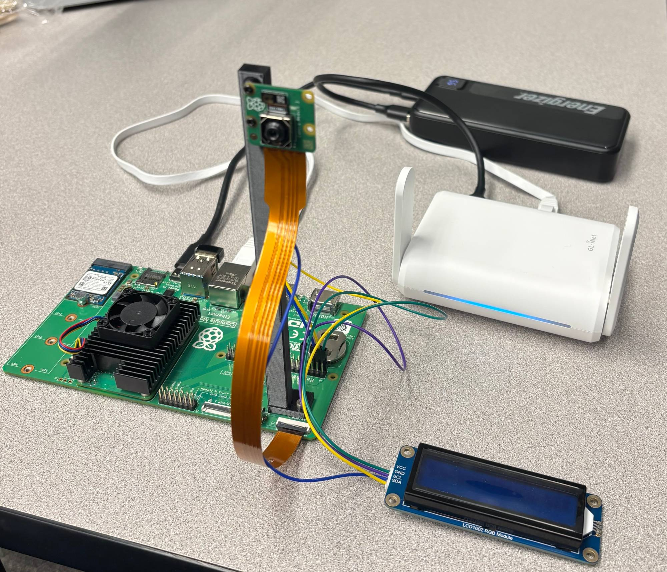
Cost: Semester 1 Demo
Item | Price
Raspberry Pi CM5 (4 GB, Lite) | $100.00
128 GB NVMe SSD (boot drive) | $44.89
GL.iNet travel router | $39.99
Energizer 20,000 mAh power bank | $29.99
Camera Module 3 | $29.25
CM5 IO Board | $20.00
LCD1602 RGB display | $17.99
Heatsink and fan | $11.99
CR2032 coin cell (clock battery) | $6.29
Camera cable | $2.70
Demo total | $303.09
Everything in the demo, powered by the power bank

Slide 2
Cost: Spent to Date
Category | Includes | Cost
Compute and storage | CM5, IO Board, cooling, SSD + enclosure, coin cell | $201.16
Motors and chassis | Chassis kit, TT motors, motor HATs and driver | $62.86
Power | Two bench supplies, power bank | $59.87
Camera and display | Camera Module 3, camera cable, LCD | $49.94
Networking | Travel router, USB Wi-Fi adapter | $49.98
Sensors and cables | IMU, line and distance sensors, I²C cables | $40.44
Total spent to date |  | $464.25
Custom PCB (not purchased): quoted $583 Itemized in Hardware/partslist.md

Slide 3
Future Work: Semester 2
Goal: drive a course on its own and obey the signs
Vehicle
• 3D-printed chassis
• Choose the motor HAT: Cokoino or Waveshare
• Motor battery and charger
Driving
• Follow the course line with the line sensors
• Use the IMU for heading and turns
• Respond to each detected sign
Software
• Connect sign detection to motor control
• Evaluate ROS 2 on the CM5
Sign model
• Ready for Semester 2
• Tune as needed once it runs on the vehicle

